Slide 1
PBIS CHAMP
Honor and Respect

Slide 2
Essential Question:
What kinds of actions and words can we use to show respect for people, property, and ourselves?

Slide 3
Ace Hymas, a high school varsity basketball player, takes a moment before every game to honor his dad.
https://www.youtube.com/watch?v=eEahD1htM6I
After the video, tell a partner your description of what respect means to you.
Allow your partner to do the same.

Slide 4
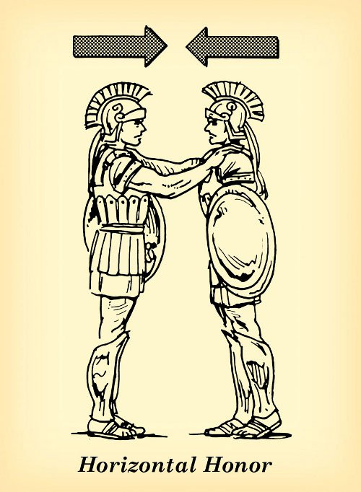
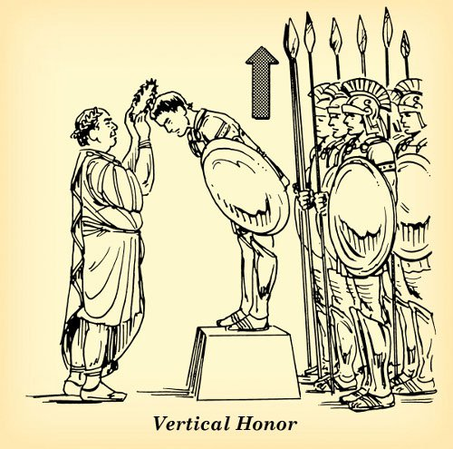
What is Honor?
Honor is a reputation worthy of
respect and admiration

Slide 5
What is Respect?
To value or regard the worth of people and things and to treat them with consideration, care, and concern.

Slide 6
What do we Value?
Brainstorm a list:
First, create a list of personal “things” you value and why.
Usefulness
Convenience
Aesthetics
Personal preference

Slide 7
Who do we Value?
Brainstorm another list:
Next, create a list of people you value and why.
Family members
Friends
Athletes
Celebrities

Slide 8
Think about it…
In a society where possessions can be more highly valued than individuals, people are more likely to disrespect one another. Is this the case in today’s world? Should it be like this? If not, what can we do to make a change?

Slide 9
With a Partner or Small Group
How is the quote related to respect? What is the deeper message?
How is this relevant to your life at school or at home?
- “He that respects himself is safe from others; he wears a coat of mail that no one can pierce.”
- “They cannot take away our self-respect if we do not give it to them.”
- “Too many people want attention- not enough want respect.”
- “I’m not concerned with your liking or disliking me… All I ask is that you respect me as a human being.”
- “I speak to everyone in the same way, whether he is the garbage man or the president of the university.”
- “An athlete who runs in a race cannot win the prize unless he obeys the rules.”
- “It is a good man who stands up for his friends, but an honorable man who stands up for his enemies.”
- “Respect is the foundation of all positive relationships.”

Slide 10
Summarize
What do others have to say about
honor and respect?
Think of examples from…
Song Lyrics?
Athletes?
Your own life?
What do you have to say about respect in school, at home, in sports, at your job, or with friends? Write your own “quote” to post within the classroom or hallway.

